Slide 1
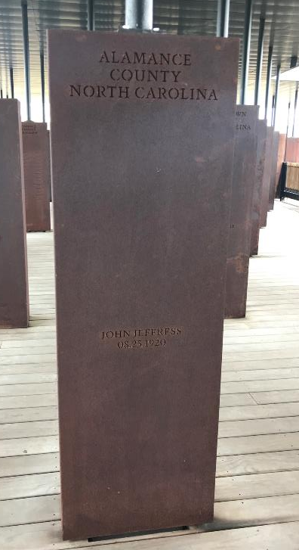
Alamance County Community Remembrance Coalition

Slide 2
About the Coalition
Formed in late 2019 after a visit to the Equal Justice Initiative in Montgomery, Alabama (www.eji.org):
  The Legacy Museum: From Enslavement to Mass Incarceration
  National Memorial for Peace and Justice
  Community Remembrance Project
An interracial group of about 20 people who live in and around Alamance County, NC, who are committed to racial justice in our county, representing many local social and racial justice groups.
Mission: Alamance County Community Remembrance Coalition memorializes documented victims of racial terror, fosters meaningful dialogue about race and justice, and educates our county about our history, using EJI projects and community events in collaboration with relevant organizations.
Vision: A diverse and equitable community transformed through healing from racial terror.

Slide 3
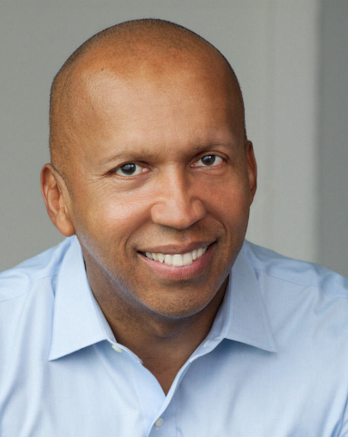
Equal Justice Initiative
Founded in 1989 in Montgomery, Alabama by Bryan Stevenson (Harvard JD – Author of “Just Mercy”)
Notes:
To understand what we are doing, we have to understand what EJI is and what they believe.

Slide 4

Equal Justice Initiative
“The Equal Justice Initiative is committed to ending mass incarceration and excessive punishment in the United States, to challenging racial and economic injustice, and to protecting basic human rights for the most vulnerable people in American society.”
Notes:
This is EJI’s mission.

Slide 5
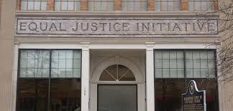
Why talk about lynchings?
We need to confront our history and the legacy of racial terror to help face the challenges of racial violence today.
Notes:
Bryan Stevenson says it best, so I’ll let him describe the importance of the work. (5 minutes)

Slide 6
Lynching in Alamance County
There are three known lynchings in the history of Alamance County
Wyatt Outlaw: 1870
William Puryear: 1870
John Jeffress: August 25, 1920

Slide 7
Wyatt Outlaw
Bi-racial - likely biological son of white Alamance County slave-owner Chesley F. Faucett and Black slave Jemimah Phillips (who was likely raped)
Served in the 2nd Regiment US Colored Cavalry from 1864-66
First African-American elected to be Town Commissioner and Constable of the town of Graham
Feb. 26, 1870 – party of unidentified men rode into Graham, dragged Outlaw out of his home and hung him from a tree in the courthouse square in Graham with a sign on his chest, “Beware, ye guilty, both black and white.”

Slide 8
William Puryear
Local African-American man with a history of speaking out against oppression and was frequently beaten for it (“I am a free man. If anyone should touch me, I’ll be damned if I don’t shoot them!”)
He tracked two Klansman – Dave and Jim Johnson to their homes and reported that they were a part of the Outlaw lynching.
A few days later, men in white gowns, with red faces broke into Puryear’s home, threatened his wife and dragged Puryear outside.
Puryear was found dead in a nearby pond a month later

Slide 9
John Jeffress
Aug. 25, 1920
Jeffress accused of attacking a female child (4-7 years of age)
Lynch mob headed by Elon College President, W.A. Harper seized Jeffress and turned him over to authorities
Mob of angry citizens “overpowered the sheriff and his assistants”; drove Jeffress to the woods on Belmont road and shot him

Slide 10
Community Involvement with EJI
Soil Collection Project
Historical Marker Project
Memorial Monument Placement
Notes:
There are three main projects with EJI that we will discuss in a little more depth; between these projects are community-building events, educational opportunities, and ways to engage a diversity of community members, including an essay contest for high-schoolers.

Slide 11
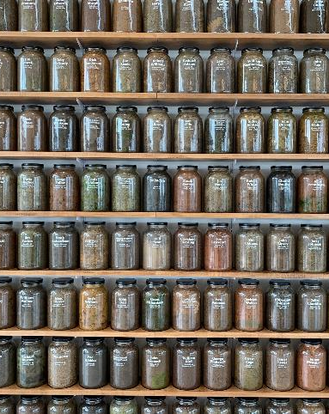
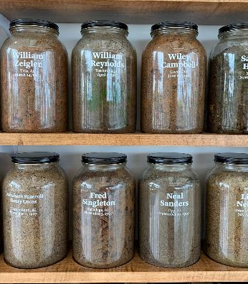
Soil Collection Project
Ceremonies for collection of soil on land where a lynching occurred.
Notes:
-In December 2020 we submitted our proposal to EJI for soil collection. They will send us the jars and we are planning for soil collection this summer, along with a ceremony and a local exhibit to honor the lives of those killed.

Slide 12
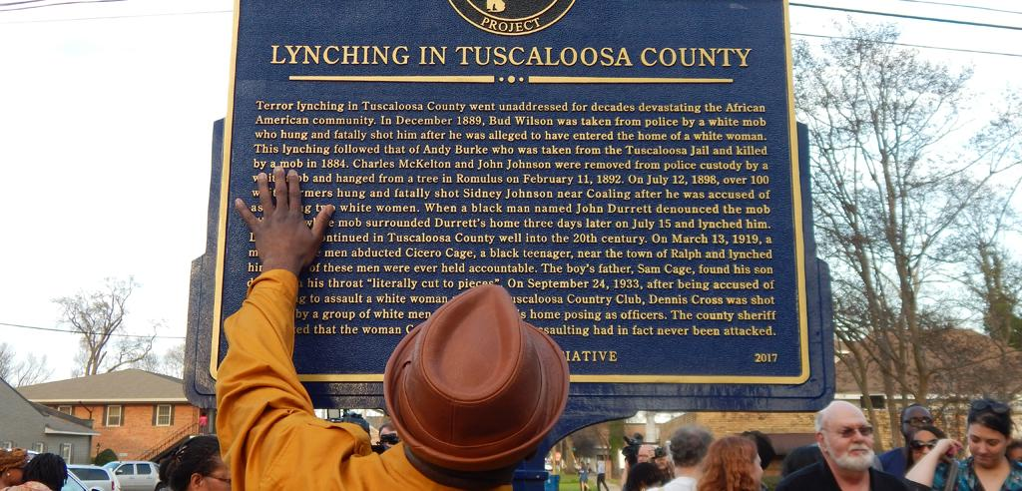
Historical Marker Project
“The public narrative a nation creates about what is important is reflected in memorials and monuments. Who is honored, what is remembered, what is memorialized tells a story about a society that can’t be reflected in other ways.”
–Bryan Stevenson, EJI Executive Director
Historical markers detail the narrative events of a specific lynching victim or group of victims.
It is an effort to build local awareness and enable truthful conversations about the legacy of racial terrorism and injustice in communities.
https://www.youtube.com/watch?v=-HHY_4f5nds&feature=youtu.be
Notes:
-EJI funds the historical marker (several thousand dollars); we have to find a space, dig a hole, and pour concrete.
-We will have another ceremony.
-There are lots of considerations here, such as location and neutralizing resistance to this effort.

Slide 13
National Memorial for
Peace and Justice
https://www.youtube.com/watch?v=BzFN9gKsf28
Notes:
Here is a clip of Bryan Stevenson with Oprah at the memorial. (2 minutes)

Slide 14
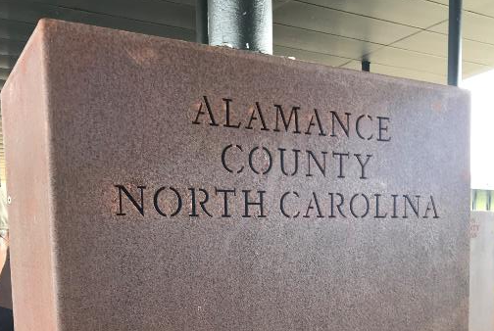
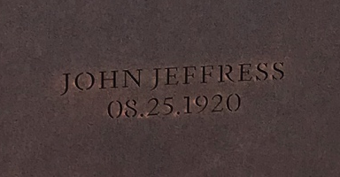

Slide 15
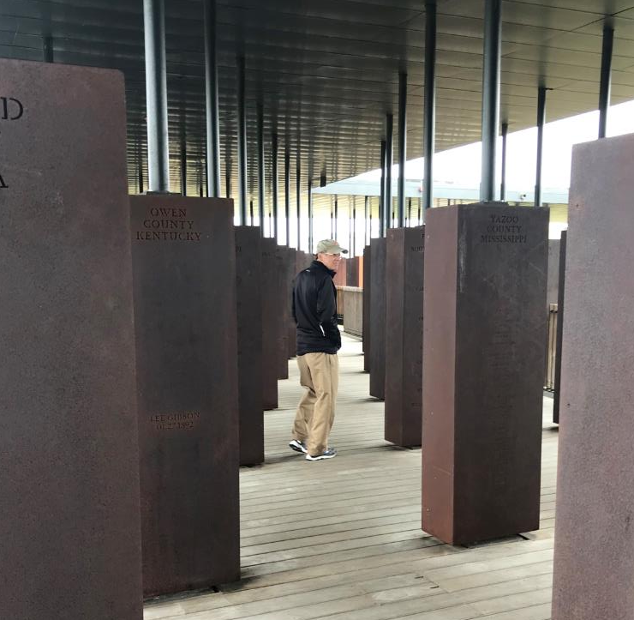

Slide 16
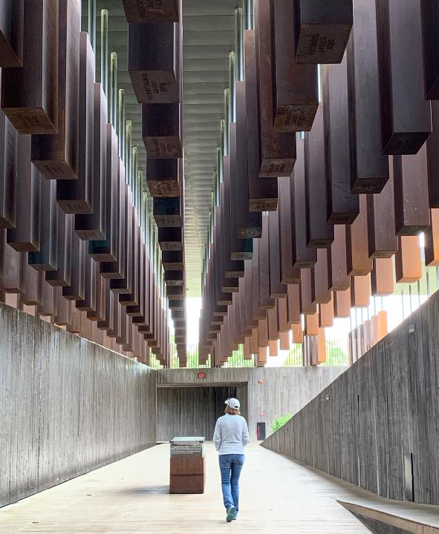

Slide 17
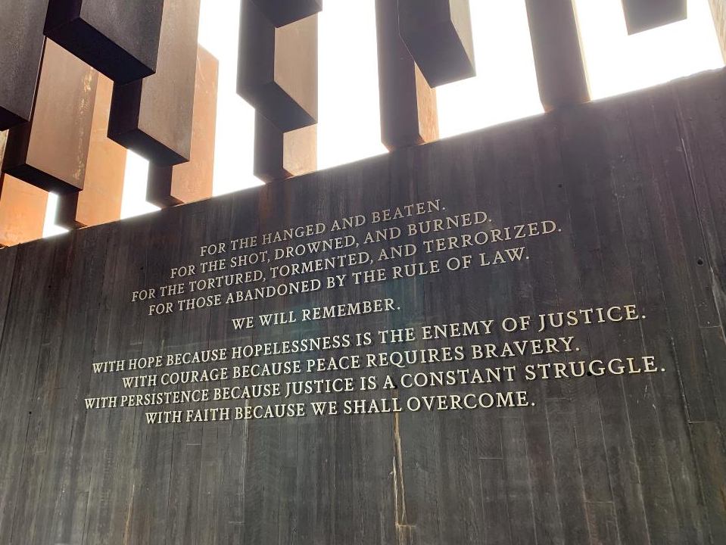

Slide 18
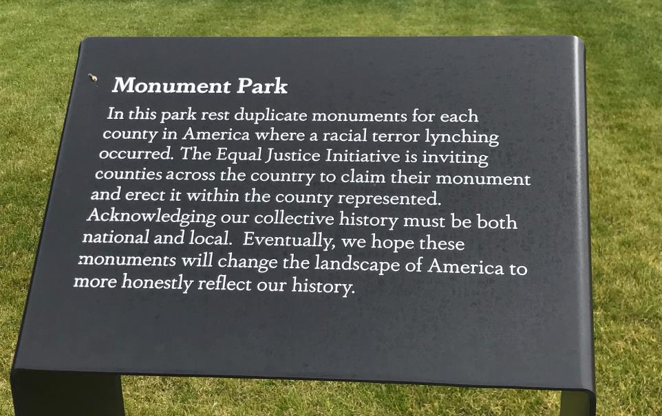

Slide 19
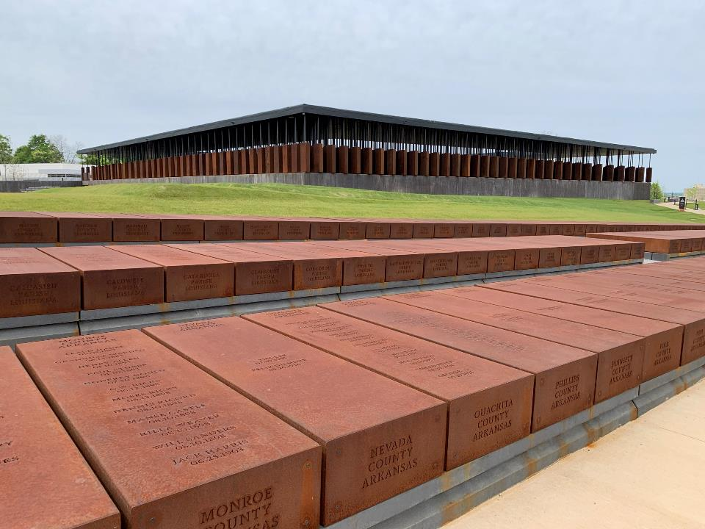

Slide 20
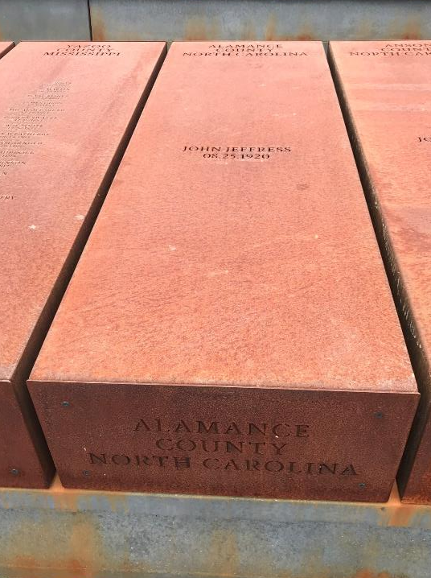
Claiming of monuments is not yet available, but EJI anticipates beginning the process soon.
Communities must have an active coalition and submit a proposal.

Slide 21
What’s coming up?
Soil Collection Proposal submitted December 2020
Planning for Soil Collection Ceremony- October 2021
Planning for a remembrance event- April 2022
Moving forward towards Historical Marker placement
Notes:
Ceremony will honor all three lives; the actual soil collection will be done in very intimate group.
We have a wealth of historical knowledge in this community, and we would like to share more about the lives that were lost to lynching and the historical context around those murders.

Slide 22
How can you support?
Provide your email so we can stay in contact with updates.
Come to our events to learn and build community.
Let us know your skills and connections; our future projects will need increasing community support.
Continue learning:
  True Justice (HBO documentary; available on youtube)
  Just Mercy by Bryan Stevenson

