Slide 1

WERA: Right to basic Amenities & 119-Bypass
NEPA Environmental Impact Statement (EIS)
Omega and Brenda Wilson, Co-Founders
West End Revitalization Association (WERA) 1994-1995
Mebane, North Carolina / Email: wera1usa@gmail.com
Original Website: www.wera-nc.org
Connecting the dots…in Old South Culture
March 2, 2020
Duke University Environmental Law & Policy Clinic, Durham, NC

Slide 2
WERA: Right to basic Amenities & 119-Bypass
NEPA Environmental Impact Statement
Brenda Wilson – Born in Philadelphia, PA; Retired Special Education Teacher, Orange County, NC; Deaconess and Food Pantry volunteer for over 200 families at Melfield United Church of Christ, Haw River, NC.
Omega Wilson – Born in Mebane, NC; Retired Independent Insurance Agency, Central Carolina Counties; former treasurer for St. Luke Christian Church, Mebane, NC (built by Omega’s freed slave ancestors in 1893).
Shaw University, Raleigh, NC – College schoolmates in the early 1970s.
Married in 1974 - Brenda’s grandparents, Luther and Mamie Burroughs, home church Mother Bethel AME Church, Center City Philadelphia, Pennsylvania.

Slide 3
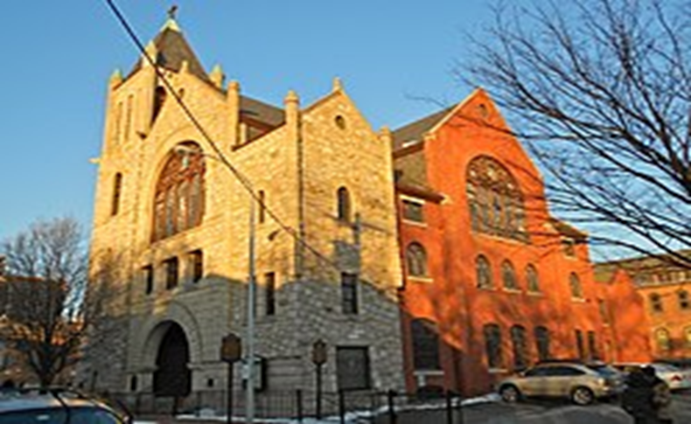

WERA: Right to basic Amenities & 119-Bypass
NEPA Environmental Impact Statement
Mother Bethel A.M.E. Church
Center City Philadelphia, PA
In 1794, Bishop Richard Allen organized the congregation and founded the oldest African Methodist Episcopal (AME) congregation in the nation. Its present church, completed in 1890, is the oldest church property in the United States to be continuously owned by African Americans. It was designated a National Historic Landmark in 1972, in order stop demolition by white residential “gentrification”. EIS???

Slide 4
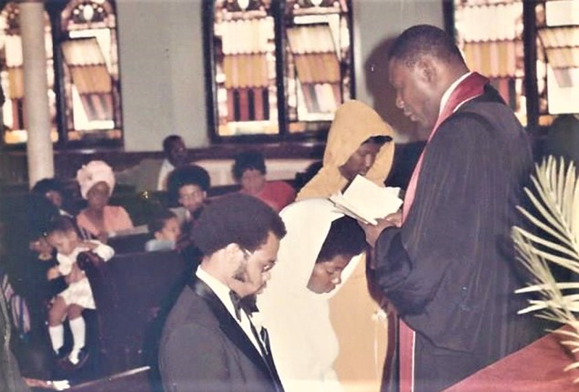

WERA: Right to basic Amenities & 119-Bypass
NEPA Environmental Impact Statement
Wedding Day!!! Omega and Brenda at the alter with Rev. Joiner officiating on September 7, 1974. Newlyweds depart historic sanctuary with wedding party and family. Mother Bethel AME had just escaped demolition two years before this blessed day.

Slide 5
WERA: Right to basic Amenities & 119-Bypass
NEPA Environmental Impact Statement
No NEPA Environment Impact States (EIS) - 1969: In 1994, North Carolina Department of Transportation (NCDOT) revealed plans to construct a 27-mile highway to Danville, VA through two historic African American and Native American heritage communities (West End and White Level) in Mebane. Residents mobilized to protect their families from the negative effects of this proposed development.
For decades, homeowners had been denied access to basic amenities, such as safe drinking water, clean groundwater protection, and connection to Mebane’s sewage treatment system, only blocks away since 1921.
Backyard septic systems had failure rates of 50-to-100 percent on some streets.
NCDOT 119-bypass/overpass would cause more exposure to air pollution, degradation to homes, forest, streams, and wetlands, which contributes to climate change. https://www.ncdot.gov/projects/nc-119/Pages/project-highlights.aspx)

Slide 6
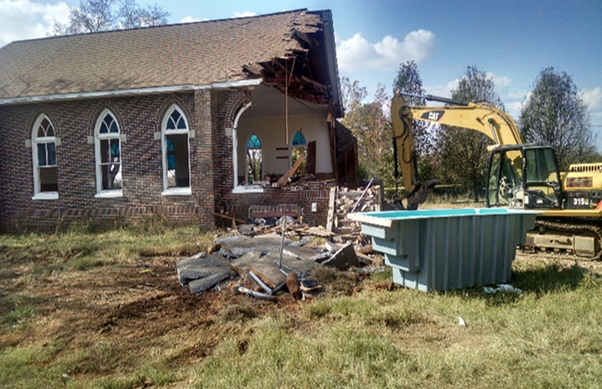
WERA: Right to basic Amenities & 119-Bypass
NEPA Environmental Impact Statement
WERA became a 501©3 non-profit in 1995 when it was discovered that City of Mebane and the NCDOT planned the 119-Bypass/overpass that would destroy St. Luke Christian Church, found in 1893 by freed slaves, the 200 year-old African American community cemetery, and over 70 homes in West End and dozens more in White Level communities. Some home are one block from two land-fields and Mebane’s sewage treatment plant built in 1921. WERA collected waters samples from drinking wells and streams that were tested at UNC-Chapel Hill and founded E. Coli and fecal coliforms.
St. Luke Christian Church Demolished by NCDOT in 2016

Slide 7
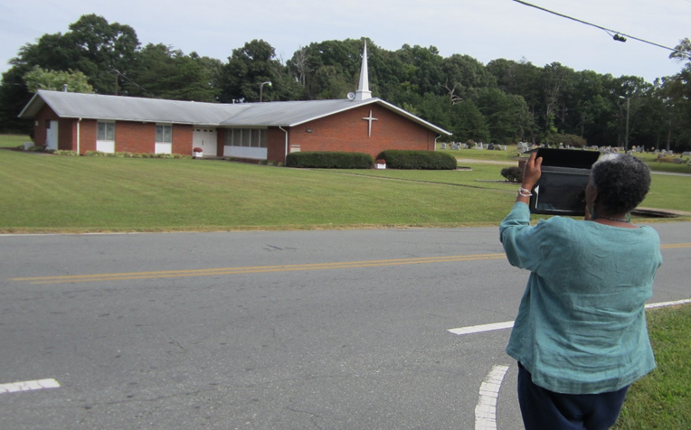
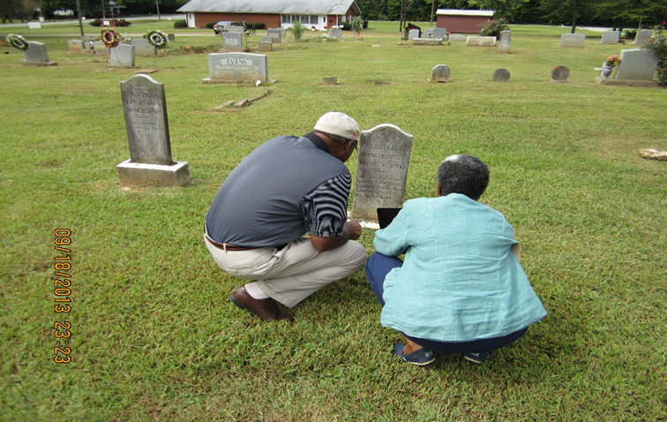
WERA: Right to basic Amenities & 119-Bypass
NEPA Environmental Impact Statement
Mebane First Presbyterian Church (corner stone 1865) founded by just freed slaves from the Scott Plantation, Haw River, NC. Family property of two North Carolina governors (W. Kerr Scott and Robert Scott) and Senator Ralph Scott. The church and 200-year old cemetery were also targeted for destruction by NCDOT and City of Mebane. Elder Donald Tate shares history with Bennett College Professor Valerie Johnson (now Dean at Shaw University, Raleigh, NC).

Slide 8
WERA: Right to basic Amenities & 119-Bypass
NEPA Environmental Impact Statement
In 1999, WERA developed a list of public health disparities and submitted administrative complaints to the U.S. Department of Justice (DOJ) under Title VI of the Civil Rights Act of 1964 and referenced the Environmental Justice Executive Order 12898 of 1994.
DOJ requested six federal government agencies to investigate their lack of oversight of civil rights laws, public health, and environmental protection statutes during the secret interagency highway planning process, in disregard for NEPA-1969 and EPA. Meetings had been going on for 16 years without opportunities for public input or an EIS. That is included DOJ’s own Civil Rights Division, DOT, EPA, HUD, USDA, and Commerce.
119-bypass/overpass meetings were conducted at Mebane's multi-million dollars golf course and country club for white residents, local, state government officials.

Slide 9
WERA: Right to basic Amenities & 119-Bypass
NEPA Environmental Impact Statement
African American communities are like men on​ death row. It's just a matter time for before they​ are executed, according a Mebane city councilman.​
USDOJ's Comments Connected the Dots
"Historic Patterns of Racial Discrimination that Deny
Basic Amenities" by "Revisionist" Local Government
Leaders. No regard for Title IV- Civil Rights Act -1964

Slide 10
WERA: Right to basic Amenities & 119-Bypass
NEPA Environmental Impact Statement
Following the WERA administrative complaints, a moratorium was placed by DOJ on NCDOT 119-bypass and overpass construction, from 1999 until 2016.
To mitigate some the potential impacts of the construction: Federal block grants ($8-Million) funded some urgent infrastructure needs in West End Community in Mebane city limits and Mebane's ETJ in Alamance County. Sewer lines were installed for 104 homes; underground petroleum storage tanks were removed from nearby commercial properties; and homes were rehabbed, sidewalks installed, and dirt streets paved for the first time.
Over 400 homes still lack these basic amenities under the authority of the City of Mebane, Alamance County, and Orange County. Some Orange County residential drinking wells have been documented to have arsenic in the water.

Slide 11
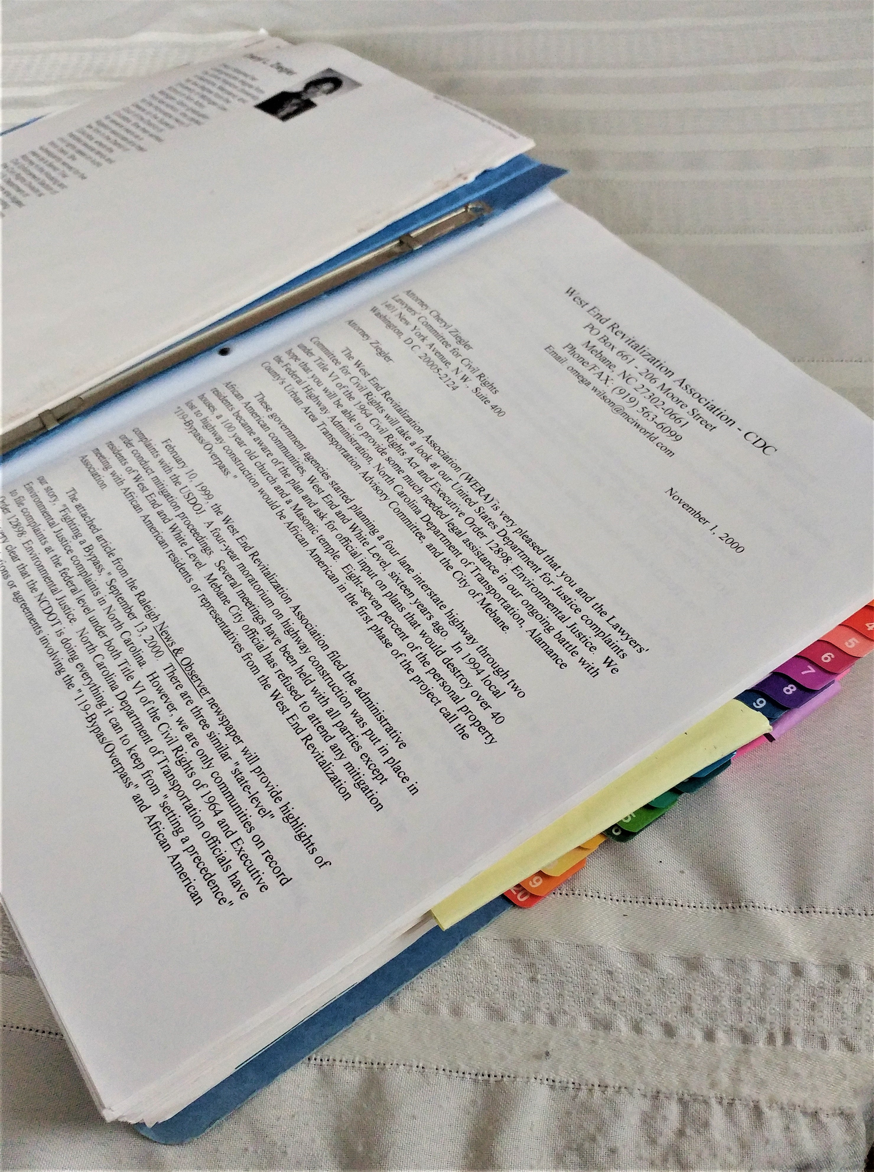
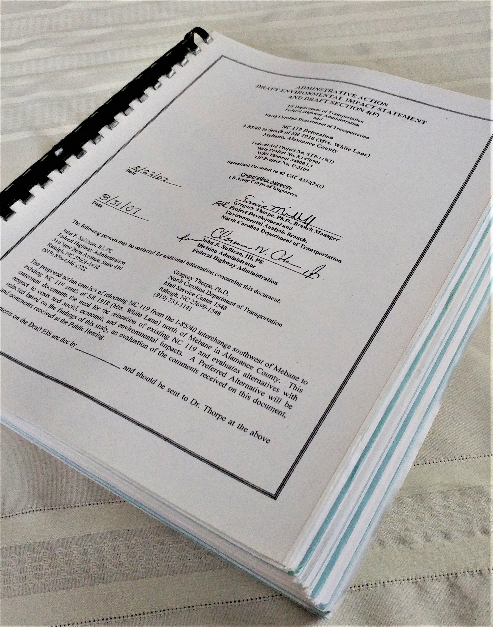
WERA: Right to basic Amenities & 119-Bypass
NEPA Environmental Impact Statement
WERA's 1999 US DOJ Complaint
With Mini Grant Funding
NCDOT's 2007 600-page NEPA EIS that References WERA & West End Community Cost Millions of Taxpayers’ Dollars
City of Mebane, Alamance County, and NCDOT planned 87-percent of property loss in four miles, from I-85/40 to US 70-HWY, would be African American in West End Community. ILLEGAL!!

Slide 12
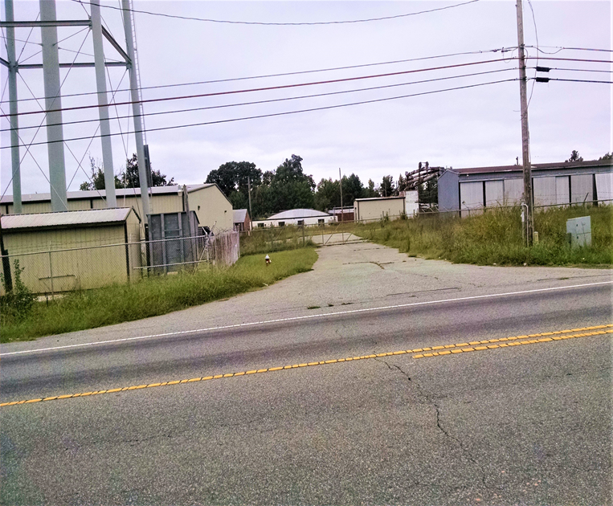
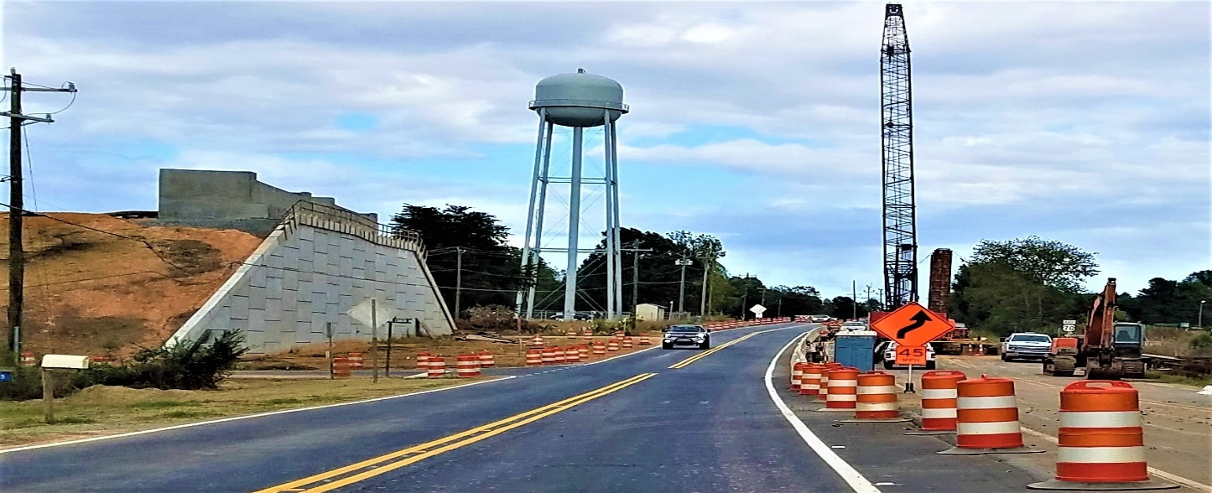
WERA: Right to basic Amenities & 119-Bypass
NEPA Environmental Impact Statement
In 2014, WERA filed interagency DOJ/EPA/NCDEQ Superfund Complaint per NCDOT EIS not including abandoned 30-acre Craftique Furniture Plant hazards. This is the site of the 119-Bypass/Overpass construction across US 70-Highway through West End Community. Complaint resulted in removal of over 5000-pounds of liquid and solid toxins and waste. Cancer-causing benzene and xylene were detected up-to 45-feet below ground at aquifer water table level in test wells by NCDENR(NCDEQ).
Before Construction>Water Tower
During Construction>Water Tower

Slide 13
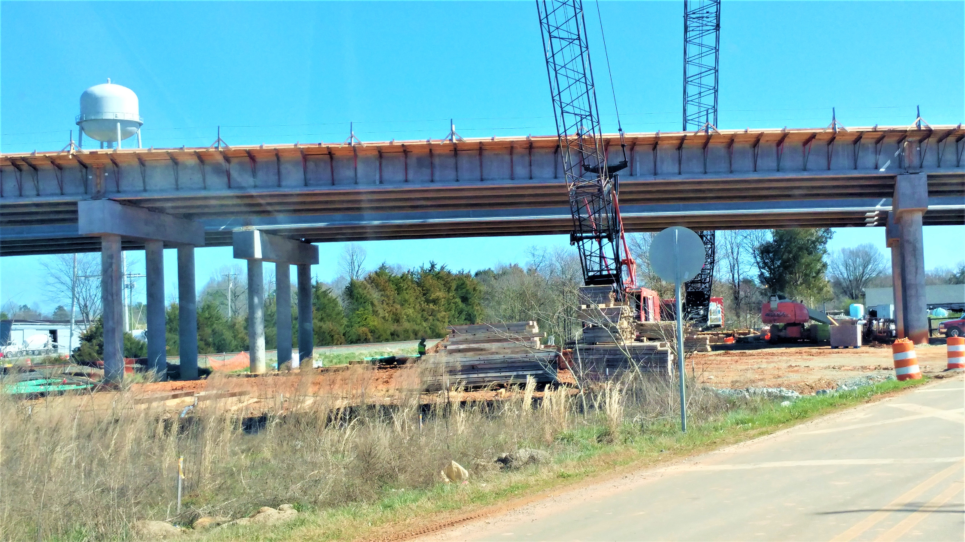
WERA: Right to basic Amenities & 119-Bypass
NEPA Environmental Impact Statement
Mile long 119-Bypass/Overpass crosses West Holt Street, railroad, industrial land, and 70-HWY through the City of Mebane. In the left backyard, water tower and contaminated abandoned Craftique Furniture Plant. EIS disregards Title VI & EJ.
Before Construction>Water Tower

Slide 14
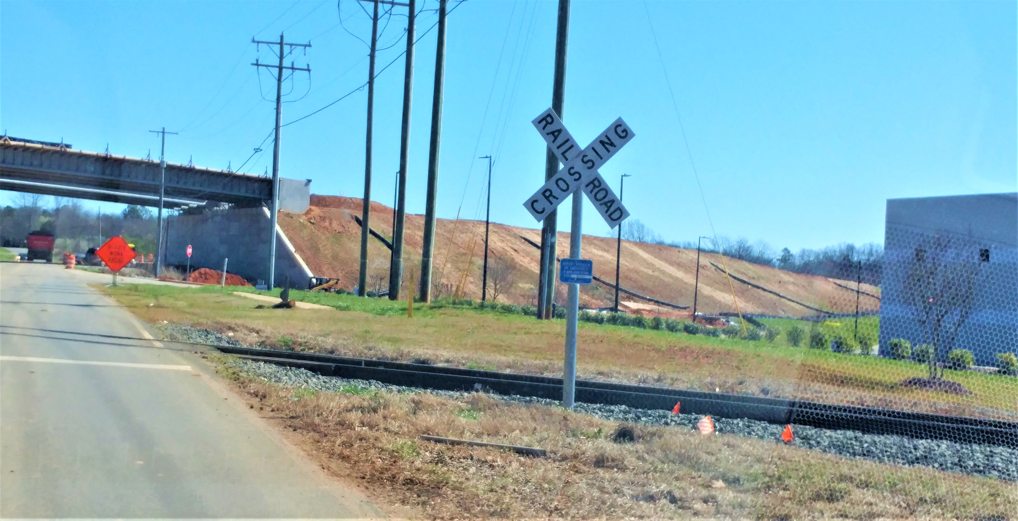
WERA: Right to basic Amenities & 119-Bypass
NEPA Environmental Impact Statement
119-Bypass/Overpass, just yards from $100-million Cambro Chemical and Plastics plant. Mebane’s police chief and fire marshal objectives to proximity. No hazmat equipment. Explosion would close 119-overpass, West Holt Street under-pass, 70-HWY, and major railroad, with black and white residents in close proximity.

Slide 15
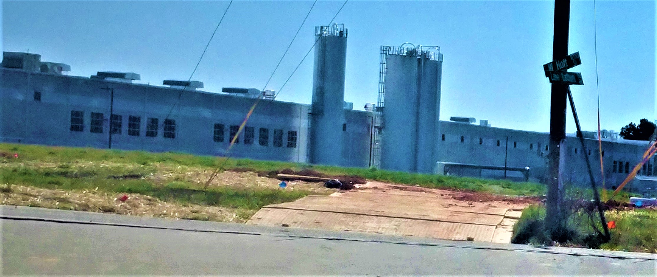
WERA: Right to basic Amenities & 119-Bypass
NEPA Environmental Impact Statement
Chemical silos - $100-million Cambro Plastics plant, at Latham Lake Road and West Holt Street. Mebane’s police chief and fire marshal objected to site plan in proximity to railroad, new bypass, and residential streets. No hazmat equipment / no training.

Slide 16
WERA: Right to basic Amenities & 119-Bypass
NEPA Environmental Impact Statement
Access to Title VI of the Civil Rights Act of 1964, Right to Basic Amenities, and accurate Environment Impact Statements do not come easy for African American and Native American homes, churches, small businesses, cemeteries, or centuries old indigenous burial and sacred grounds.
Questions
Thank You!!!
“Connect the Dots…in Old South Culture”

